Slide 2

Major Project- 1
House Price Prediction Using Machine Learning
Name | Branch | Sap Id
Shreya Sharma | B.Tech C.S.E. (B.A.O) | 500077712
Shivani Saran | B.Tech C.S.E. (B.A.O) | 500075219
Tanisha Pathak | B.Tech C.S.E. (C.S.F) | 500076504
Under the guidance of
Dr. Bikram Pratim Bhuyan

Slide 3
Abstract
House Price Prediction (HPI) is commonly used to estimate the changes in
housing price. As, house prices is dependent on many factors, like location, size,
population, etc., it requires other information apart from HPI to predict individual
house prices.

Slide 4
Introduction
The problem falls under the category of Supervised Learning algorithms. The
dataset we’ll be using, comprises of some input features and one target feature. The
input features include features that may or may not impact the price.

Slide 5

Problem Statement
We are given dataset of house prices with some features like no. of rooms, location,
area, etc. Our task is to create a model which will predict the price for any new house
by looking at its features.

Slide 6

Predict the price of any new house based on its
feature, which will include
following sub objectives:
• Finding the type of model to build
• Selecting a performance measure
• Checking assumptions
Objective

Slide 7
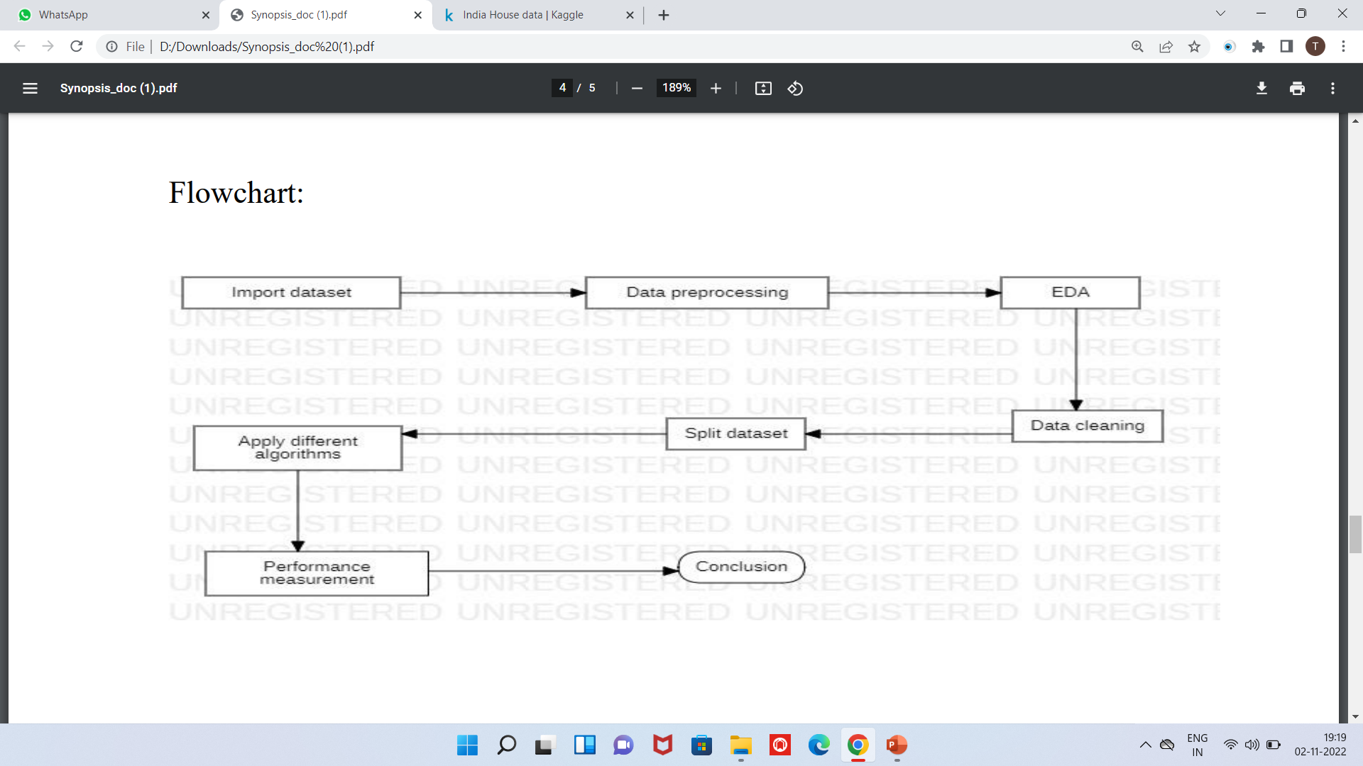
FLOW CHART

Slide 8
Methodology
We will use a test driven approach to build a model using Python from and then we
will use trained model to predict house sale prices and extend it further.
Steps:
• Import dataset and necessary libraries
Accurately predicting house prices can be a daunting task. The buyers are just not concerned about the size(square feet) of the house and there are various other factors that play a key role to decide the price of a house or property.
• Data pre-processing
• Exploratory data
analysis
• Data cleaning

Slide 9
Methodology
Split dataset into training and test set
Model and accuracy
Compare and find the most suitable algorithm

Slide 10
Algorithms
Linear Regression
Decision Tree
Define
Groups
Linear Regression is a machine learning algorithm based on supervised learning. It performs a regression task. Regression models are target prediction value based on independent variables. It is mostly used for finding out the relationship between variables and forecasting.
A decision tree is a type of flowchart that shows a clear pathway to a decision. In terms of data analytics, it is a type of algorithm that includes conditional ‘control’ statements to classify data.

Slide 11
Algorithms
Elastic net Algorithm:- Elastic-Net Regression is a modification of Linear Regression which shares the same hypothetical function for prediction
Random Forest Algorithm:-Random forest algorithm creates decision trees on data samples and then gets the prediction from each of them and finally selects the best solution by means of voting.
Bayesian Ridge:- The output or response ‘y’ is assumed to drawn from a probability distribution rather than estimated as a single value.

Slide 12
Algorithms
Ridge Algorithm:- Ridge regression is one of the types of linear regression in which a small amount of bias is introduced so that we can get better long-term predictions.
Ridge regression is a regularization technique, which is used to reduce the complexity of the model.
Lasso Algorithm:- Lasso regression is another regularization technique to reduce the complexity of the model. It stands for Least Absolute and Selection Operator.
It is similar to the Ridge Regression except that the penalty term contains only the absolute weights instead of a square of weights.

Slide 13


SWOT ANALYSIS
STRENGTHS
WEAKNESSES
Simple model
2. Computationally efficient
3. Interpretability of the output
Overly-simplistic
2. Independence of variables
3. Inability to determine feature importance
SWOT
OPPORTUNITIES
THREATS
Data security improvement
More accessible
1. If data cleaning is not done efficiently, then the outcome would not be as desired.

Slide 14
APPLICATIONS
01
Real estate
02
Corporate Sectors
03
Government Sectors (Ministry of Statistics)
04
Investors

Slide 15
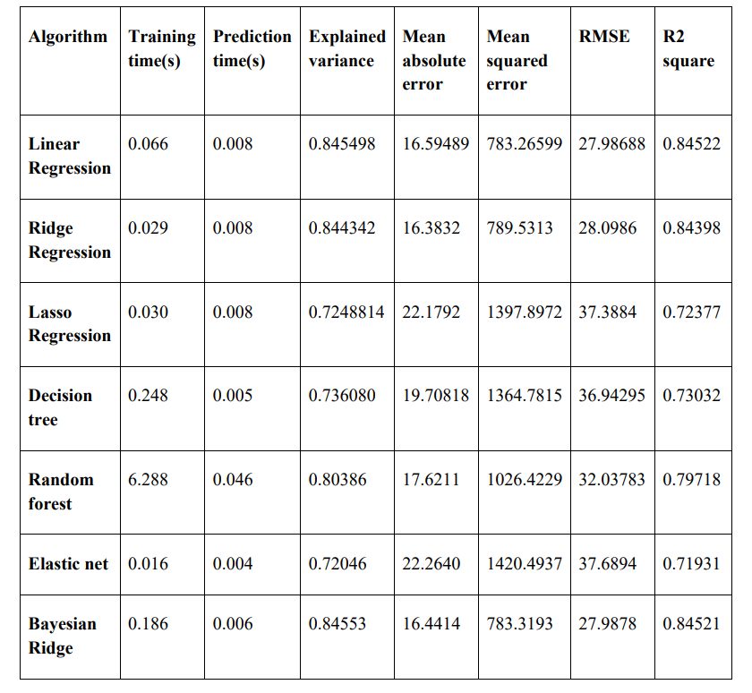
Comparative analysis

Slide 16
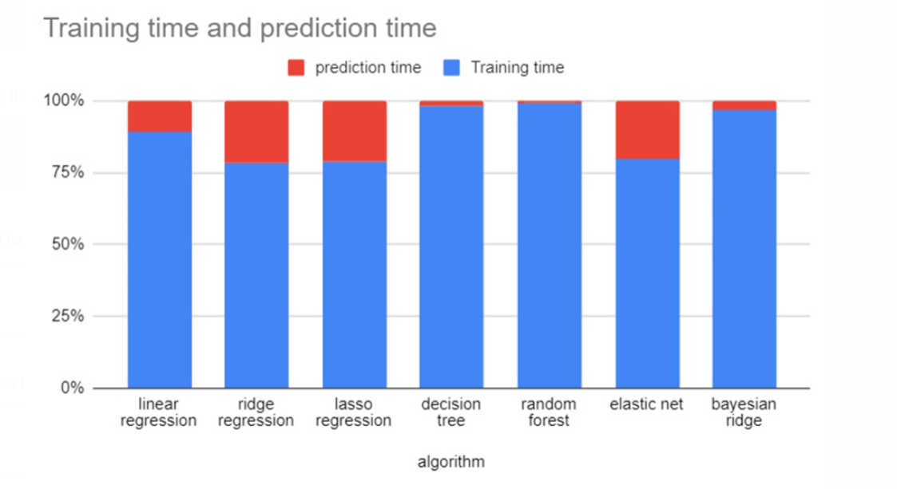
RESULT

Slide 17
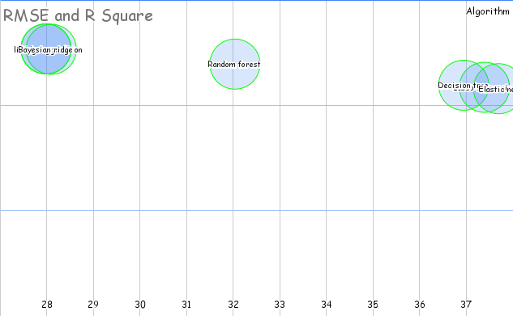
Conclusion

Slide 18
References
Mr. Piyush Chordia, Mr. Pratik Konde, Ms. Supriya Jadhav, Hrutik Pandhare, Prof. Shikha Pachouly. Prediction of House Price Using Machine Learning 2022. https://doi.org/10.22214/ijraset.2022.40466
Lu Wang,Guangxing Wang,Huan YuORCID Icon &Fei Wang. Prediction and analysis of residential house price using a flexible spatiotemporal model 2022 https://www.tandfonline.com/doi/full/10.1080/15140326.2022.2045466
Qingqi Zhang. Housing Price Prediction Based on Multiple Linear Regression 2021 https://doi.org/10.1155/2021/7678931
4. Ahmad Abdulal Nawar Aghi. House Price Prediction 2020 https://www.divaportal.org/smash/get/diva2:1456610/FULLTEXT01.pdf

Slide 19
THANK YOU

